Slide 1

Real Time Embedded Systems PBL- Real Time Smart Helmet for Mining/Industrial Safety
Group Members: Abdul Ahad Muhammad Rehan Ali

Slide 2
Interface design
Software & Hardware Interfaces:
FreeRTOS API: Task management, queues, semaphores
ESP-IDF Libraries: WiFi, HTTP client, GPIO, ADC, I2C drivers
Communication Protocol: HTTP POST/GET to Flask server (JSON format)
User Interface: Web-based dashboard (Python Flask + HTML/CSS/JavaScript)
Data Flow Architecture:
Sensors → FreeRTOS Tasks → Alert Queue → Alert Management ↓ Buzzer/Vibration ↓ WiFi → Command Center
Interface Type | Component | Protocol/Method | GPIO/Channel
Digital I/O | Buzzer | GPIO Output | GPIO 25
 | Vibration Motor | GPIO Output | GPIO 26
 | SOS/Cancel Button | GPIO Input (Interrupt) | GPIO 27
Analog Input | MQ-7 Gas Sensor | ADC (with voltage divider) | GPIO 36 (ADC1_CH0)
I2C Bus | MPU6050 (IMU) | I2C Master | SDA: GPIO 21, SCL: GPIO 22
1-Wire Protocol | DHT22 (Temp/Humidity) | Bit-banging | GPIO 4
Wireless | WiFi Module | Built-in ESP32 WiFi | Internal

Slide 3
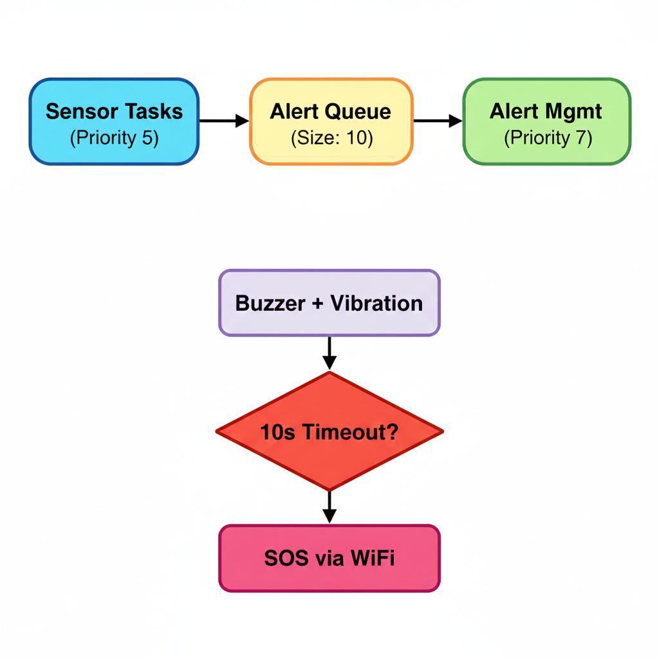
Task List
FreeRTOS Task Architecture
Task Interactions
Task Name | Priority | Period | Stack Size | Function
gas_sensor_task | 5 | 2000ms | 4096 bytes | Monitor CO levels via MQ-7
temp_humidity_task | 5 | 3000ms | 4096 bytes | Read DHT22 temperature & humidity
imu_task | 5 | 500ms | 4096 bytes | Detect falls via MPU6050 accelerometer
alert_management_task | 7 (Highest) | 100ms | 4096 bytes | Control buzzer, vibration, SOS escalation
status_report_task | 4 | 30000ms | 4096 bytes | Send periodic updates to command center
Synchronization Mechanisms
Queue: Alert_queue - Producer: sensor tasks, Consumer: alert management
Semaphore: Binary semaphore for button debouncing (via ISR flag)

Slide 4
Interrupt sources
Hardware Interrupts Implemented
Interrupt Source | GPIO | Trigger Type | ISR Handler | Purpose
SOS/Cancel Button | GPIO 27 | Falling Edge | cancel_button_isr_handler() | User acknowledgment of alert
MPU6050 Data Ready | GPIO 35 | Rising Edge | mpu6050_isr_handler() | Notify IMU task of new data
Interrupt Service Routine (ISR) Design
Cancel Button ISR:
Fast execution: Only sets a flag, no blocking operations
IRAM attribute: Code stored in RAM for faster access
Debouncing: Handled in main task (checks flag every 100ms)
MPU6050 ISR:
Task notification: Wakes up IMU task immediately
Context switch: May switch to higher priority task if needed

Slide 5
Potential Schedulars
Scheduler Options Analysis
FreeRTOS Scheduling
Timeline (ms): 0 100 200 300 400 500 ┌────┬────┬────┬────┬────┬────┐ Alert Task │ ██ │ │ ██ │ │ ██ │ │ Priority 7 (runs every 100ms) (Priority 7) └────┴────┴────┴────┴────┴────┘ ┌────┬────┬────┬────┬────┬────┐ IMU Task │ ██ ██ ██ ██ ██ ██ ██ │ Priority 5 (runs every 500ms) (Priority 5) └────┴────┴────┴────┴────┴────┘ ┌────┬────┬────┬────┬────┬────┐ Temp Task │ ███ ███ │ Priority 5 (runs every 3000ms) (Priority 5) └────┴────┴────┴────┴────┴────┘ Alert task preempts lower priority tasks when alarm triggered
Feature | FreeRTOS (Selected) | Round-Robin | Rate Monotonic
Scheduling Algorithm | Priority-based preemptive | Time-slice equal distribution | Fixed-priority by period
Priority Levels | 256 levels (configurable) | None (all equal) | Based on task period
Preemption | Yes | No | Yes
Real-time Guarantees | Soft real-time | None | Hard real-time
Task Priorities | User-defined | N/A | Shorter period = Higher priority
Context Switch Overhead | Low (~1-2µs) | Medium | Low
Use Case | General-purpose RTOS | Simple, non-critical | Periodic tasks only

Slide 6
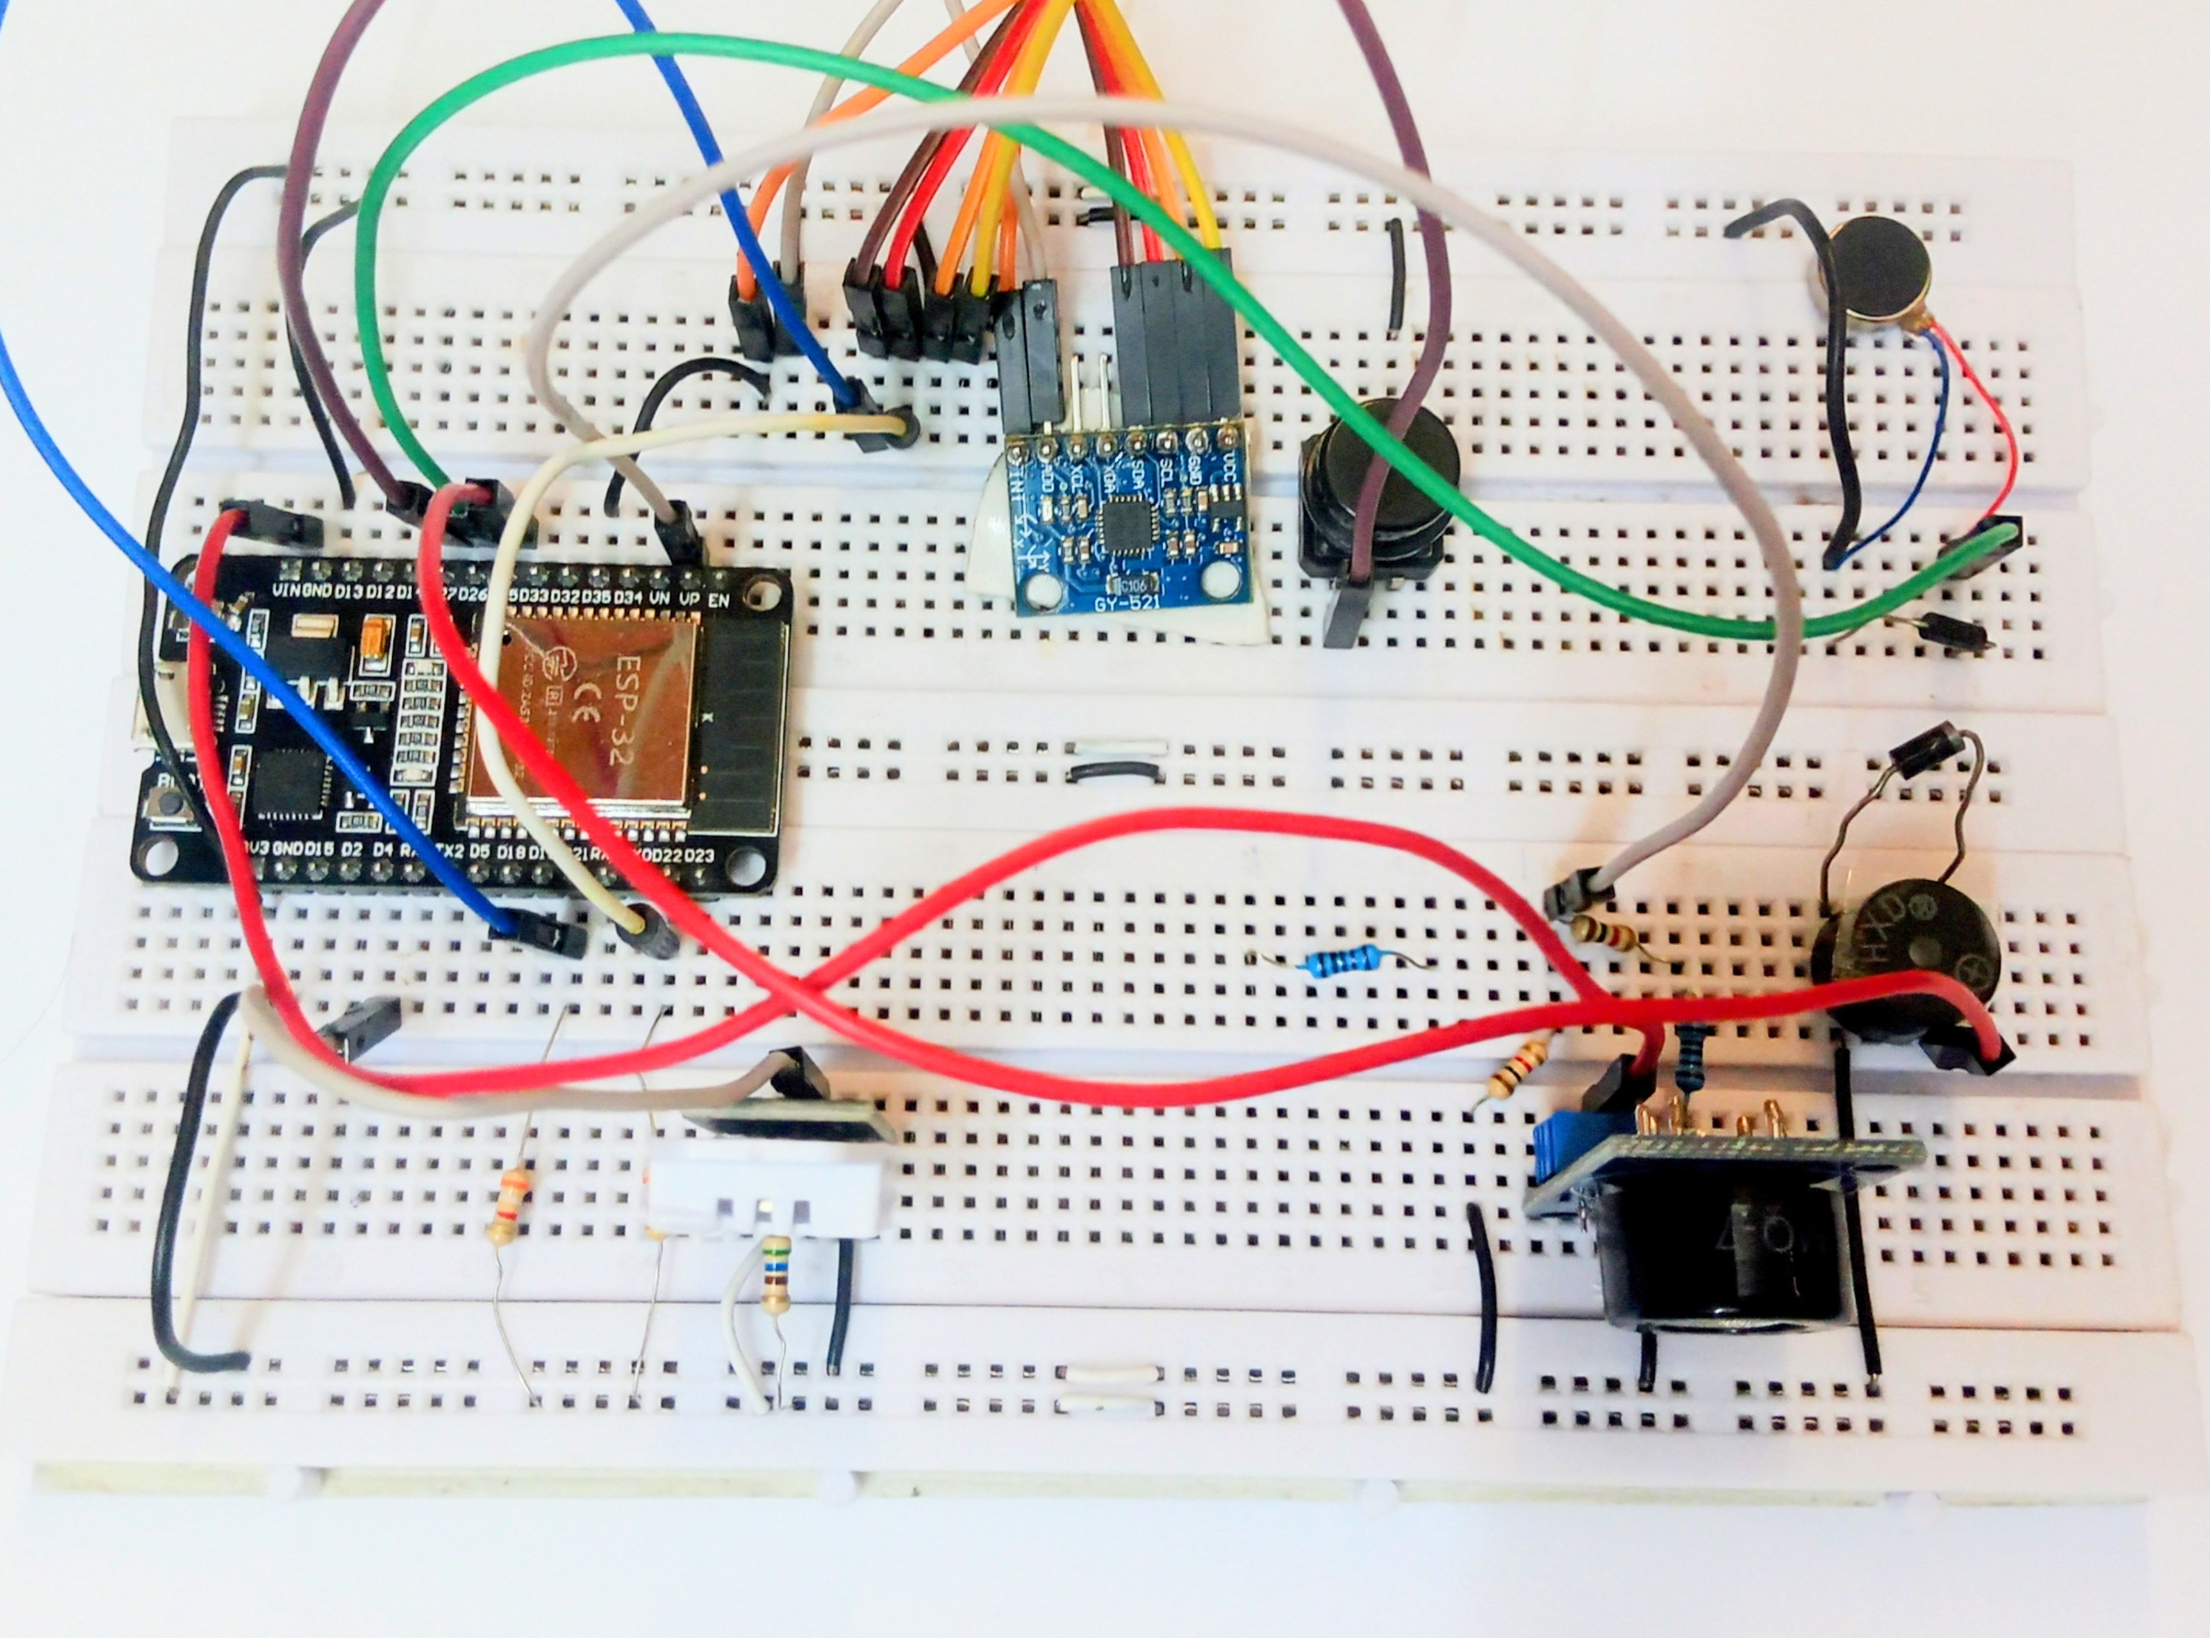
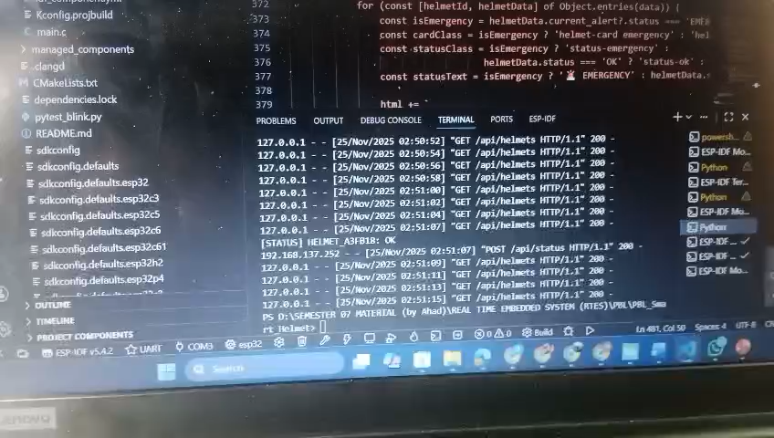
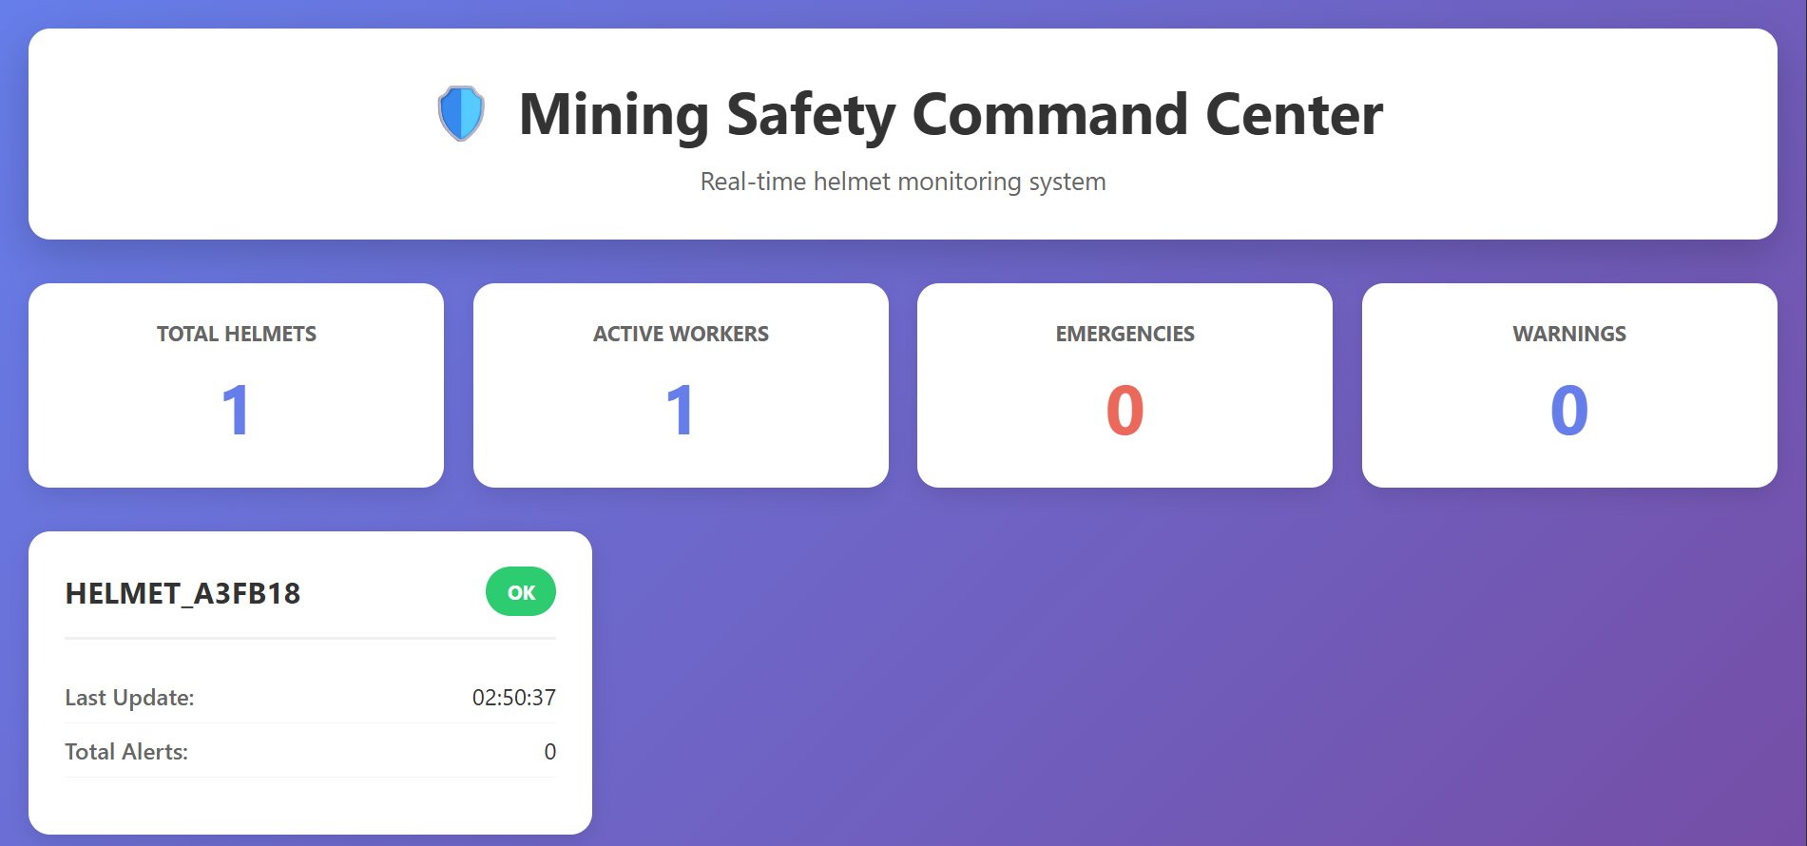
Current Progress

